Slide 1
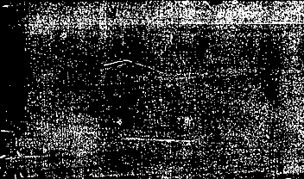
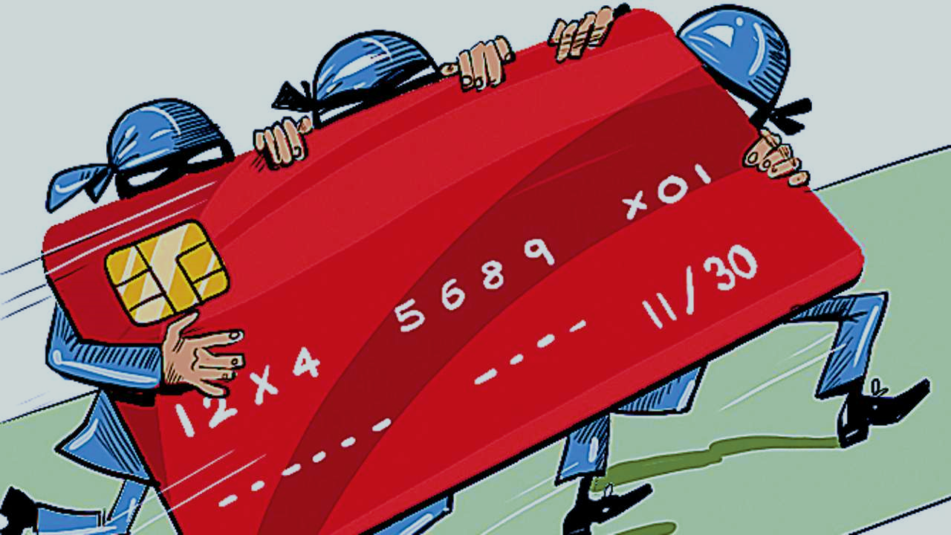

Credit Card Fraud Analytics
Team:
Gyan Prakash, Yufei Wang, Wei Tang, William Staudenmeier,
Alok Abhishek, Weichen Zhang, Pratyush Shankar

Slide 2
Executive Summary
Objective
Build a supervised learning model to detect fraudulent credit card transactions
Data Analysis Methods
5 step approach from data exploration, imputation, expert variable creation, feature selection and data modeling
Conclusions
Our best model, Bootstrap Forest, gave an FDR at 2% of 52.37% on OOT dataset.

Slide 3
Problem Statement
About 31.8 million U.S. consumers had their credit cards breached in 2014
As per studies in 2007 for every $100 of transaction $0.07 was lost due to fraud
As part of this project we are building a supervised learning model to identify fraudulent credit card transactions

Slide 4
Process Overview
Data Discovery and initial analysis
Data Visualization and understanding
Expert variable creation using training data set
Data imputation
Feature Selection (KS + LASSO)
Data Partition – Training, Testing and OOT
Predictive Modeling

Slide 5
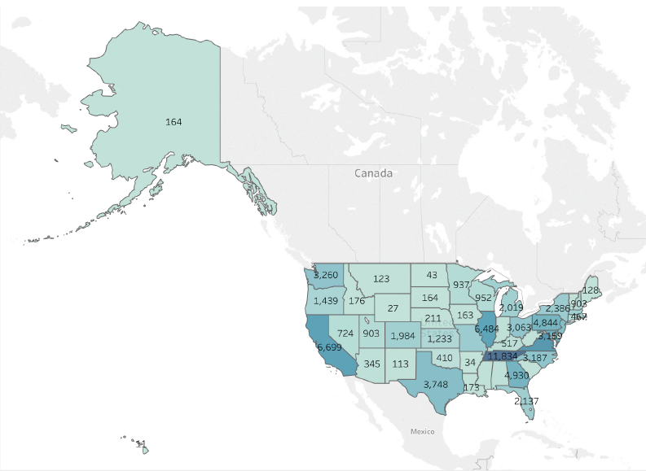
Data Description
One year of credit card transaction data for Gov. Agency
96,707 sample transaction labeled with fraud/not fraud
6.26 MB and 10 columns
The data contains following information:
Card number
Date of transaction
Merchant number
Merchant description
Merchant state
Merchant zip
Transaction type
Transaction amount
Fraud label

Slide 6
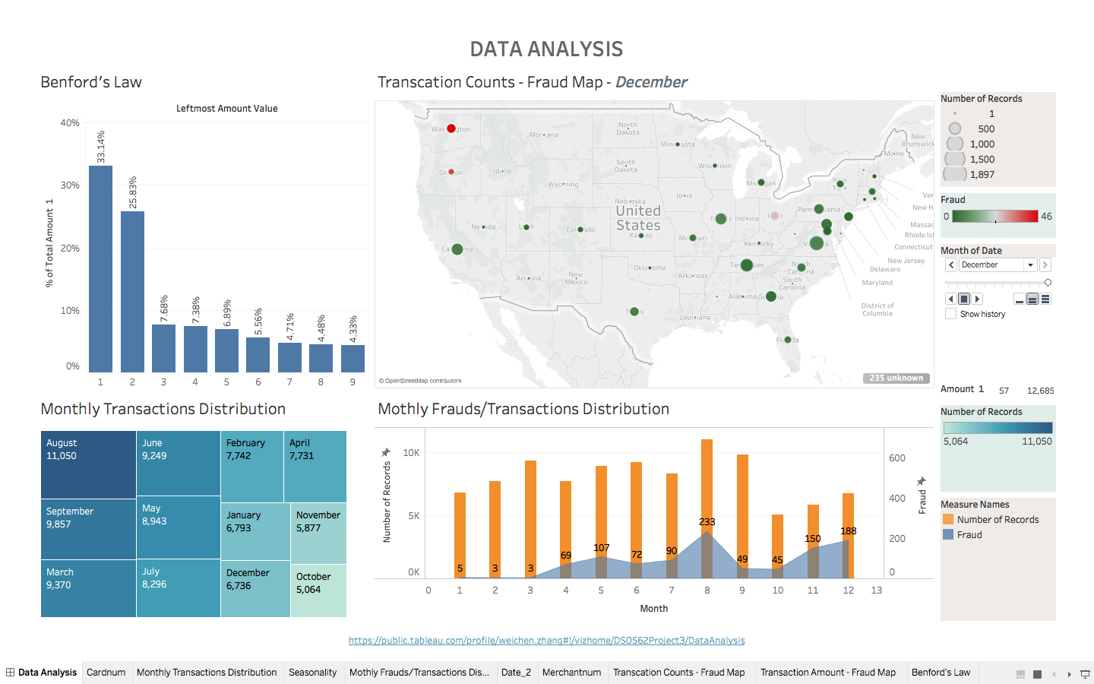
Data Visualization - 1
Notes:
To describe data better and dig the relations among the datast, we create a Tableau dashboard.The upper left graph describes Benford’s Law. We use transcation amount as our dimension. It looks a little bit awkward, but the general trend is OK. The number, 1 has the largest proportion and the following numbers show a decreasing trend, Only useful when a potential fraudster, our professor, is making up a large amount of numbers so one can reasonably examine the distribution. The upper right graph is the geography distribution of Transction counts and fraud counts. The bigger those circles are, the more regards in those states. This is a example for December’s data. Actually, this graph can change as the time changes, but somehow Tableau dashboard cannot be insert into PPT, so we just use a screenshot.The lower left graph is the tree graph monthly distribution of transactions. We can see August has a greatest number, which is 11,050. followed by September, March. The least group belongs to October ,which is less than half of August’s data. The lower right graph is the bar chart of … We can the number of frauds and transactions has some relations, but weak relations. As the numbers of transactions go up, the number of fraud will increase.

Slide 7
Data Visualization - 2
Notes:
To describe data better and dig the relations among the datast, we create a Tableau dashboard.The upper left graph describes Benford’s Law. We use transcation amount as our dimension. It looks a little bit awkward, but the general trend is OK. The number, 1 has the largest proportion and the following numbers show a decreasing trend, Only useful when a potential fraudster, our professor, is making up a large amount of numbers so one can reasonably examine the distribution. The upper right graph is the geography distribution of Transction counts and fraud counts. The bigger those circles are, the more regards in those states. This is a example for December’s data. Actually, this graph can change as the time changes, but somehow Tableau dashboard cannot be insert into PPT, so we just use a screenshot.The lower left graph is the tree graph monthly distribution of transactions. We can see August has a greatest number, which is 11,050. followed by September, March. The least group belongs to October ,which is less than half of August’s data. The lower right graph is the bar chart of … We can the number of frauds and transactions has some relations, but weak relations. As the numbers of transactions go up, the number of fraud will increase.

Slide 8
Data Visualization - 3
Notes:
To describe data better and dig the relations among the datast, we create a Tableau dashboard.The upper left graph describes Benford’s Law. We use transcation amount as our dimension. It looks a little bit awkward, but the general trend is OK. The number, 1 has the largest proportion and the following numbers show a decreasing trend, Only useful when a potential fraudster, our professor, is making up a large amount of numbers so one can reasonably examine the distribution. The upper right graph is the geography distribution of Transction counts and fraud counts. The bigger those circles are, the more regards in those states. This is a example for December’s data. Actually, this graph can change as the time changes, but somehow Tableau dashboard cannot be insert into PPT, so we just use a screenshot.The lower left graph is the tree graph monthly distribution of transactions. We can see August has a greatest number, which is 11,050. followed by September, March. The least group belongs to October ,which is less than half of August’s data. The lower right graph is the bar chart of … We can the number of frauds and transactions has some relations, but weak relations. As the numbers of transactions go up, the number of fraud will increase.

Slide 9
Data Visualization - 4
Notes:
To describe data better and dig the relations among the datast, we create a Tableau dashboard.The upper left graph describes Benford’s Law. We use transcation amount as our dimension. It looks a little bit awkward, but the general trend is OK. The number, 1 has the largest proportion and the following numbers show a decreasing trend, Only useful when a potential fraudster, our professor, is making up a large amount of numbers so one can reasonably examine the distribution. The upper right graph is the geography distribution of Transction counts and fraud counts. The bigger those circles are, the more regards in those states. This is a example for December’s data. Actually, this graph can change as the time changes, but somehow Tableau dashboard cannot be insert into PPT, so we just use a screenshot.The lower left graph is the tree graph monthly distribution of transactions. We can see August has a greatest number, which is 11,050. followed by September, March. The least group belongs to October ,which is less than half of August’s data. The lower right graph is the bar chart of … We can the number of frauds and transactions has some relations, but weak relations. As the numbers of transactions go up, the number of fraud will increase.

Slide 10
Data Cleaning
Three variables -- merchnum, merch.state and merch.zip are not 100% populated, with missing values and 0’s.
We assigned values to these fields based on merch.description. We considered records with different merch.description as different merchants, and assumed that each merchant should have a unique merchant number, be in one state, and only have one zip code.
We skipped missing values while counting linkages to create expert variables
Since all these three variables are categorical, we assigned unique values in these fields according to merch.description, and those values were designed to be quite different from other existing values

Slide 11

Expert Variable Creation
Since this analysis involves time, with limited data, we chose four different time windows 1, 3, 7, 15 and 30 days.
The rationale is to capture more (and different types of) fraudulent records that might be detected in those time windows.
We did not use fraud label to create expert variable to represent more real world scenerio

Slide 12

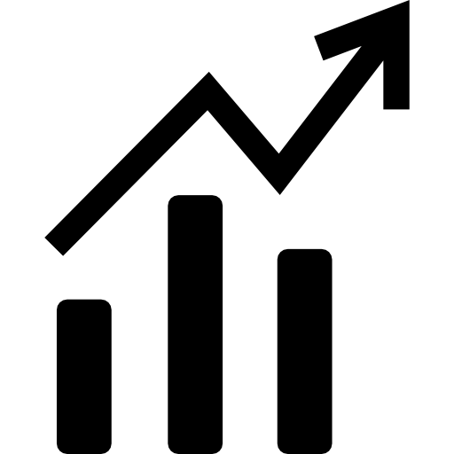

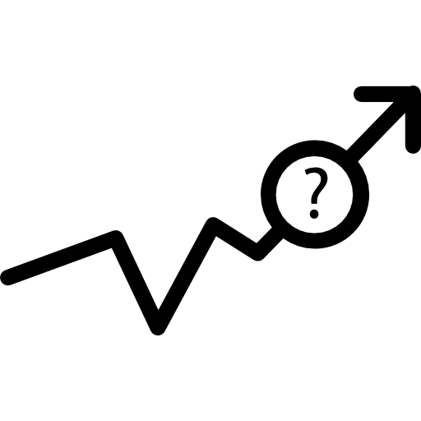
Expert Variable Creation
Type I variables are intended to capture unusual amounts of transaction, both at the card level and the merchant level
Type 2 variables are intended to capture unusual transaction frequency during a set period of time, both at the card level and the merchant level
Type 3 are location related variables, which are intended to capture merchants with different zip codes and states in a set period of time.
Type 4 are intended to catch card appearance pattern, either for a merchant or for a card holder.

Slide 13
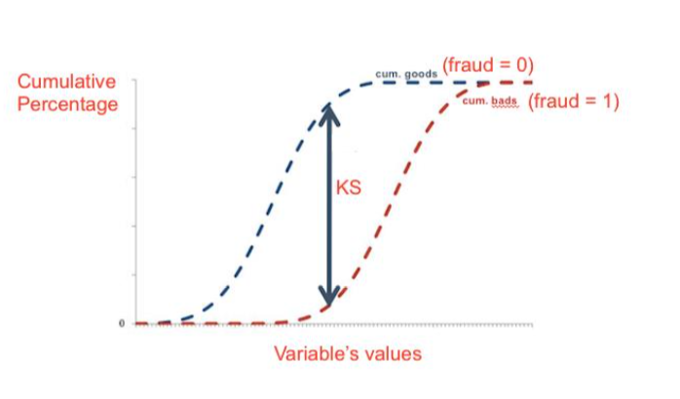
Feature Selection - KS & Lasso
KS: KS is a robust measure of how well two distributions are separated (goods vs bads)
Lasso: Lasso can solve the multicollinearity problem between variables
KS Lasso
130 variables →→ 40 variables →→ 25 variables

Slide 14
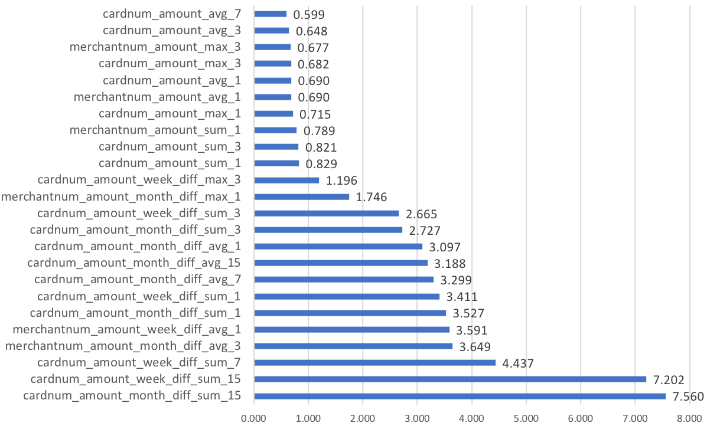
Gini Index – Variable Importance
The Gini coefficient measures the inequality among values of a frequency distribution

Slide 15
FDR at 2% for Different Models
 | Bootstrap Forest | Boosted Trees | Neural Network | Naive Bayes | Logistic Regression
Training | 66.51% | 64.41% | 70.89% | 59.98% | 62.13%
Testing | 58.94% | 53.61% | 60.08% | 50.00% | 49.05%
OOT | 52.37% | 51.48% | 42.31% | 38.78% | 47.63%

Slide 16
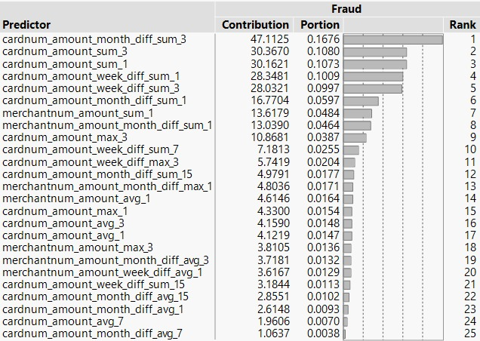
Variable Importance based on Bootstrap Forest

Slide 17
ROC Curve – Bootstrap forest

Slide 18
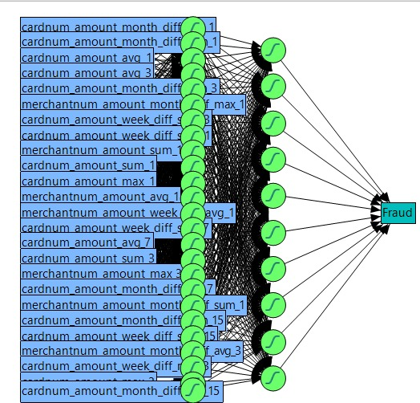
Neural Network (Nodes: 25, 10)

Slide 19
Bin Table

Slide 20
Conclusion
$237,000
Assume $1000 loss for every fraud that’s not caught
Assume $10 loss for every false positive (good that’s flagged as a bad)
Cut off: 16.5%
12,586

Slide 21
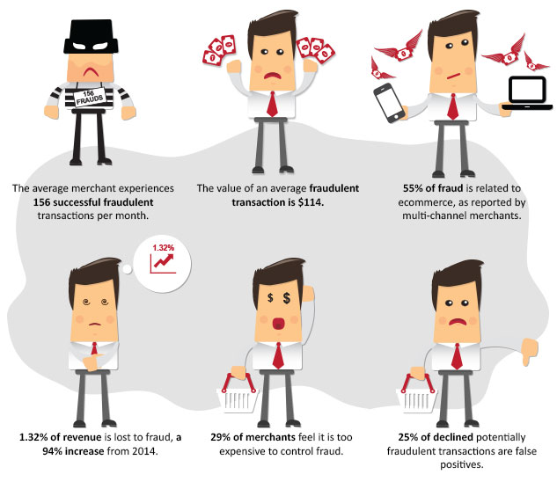
Business Insights

Slide 22
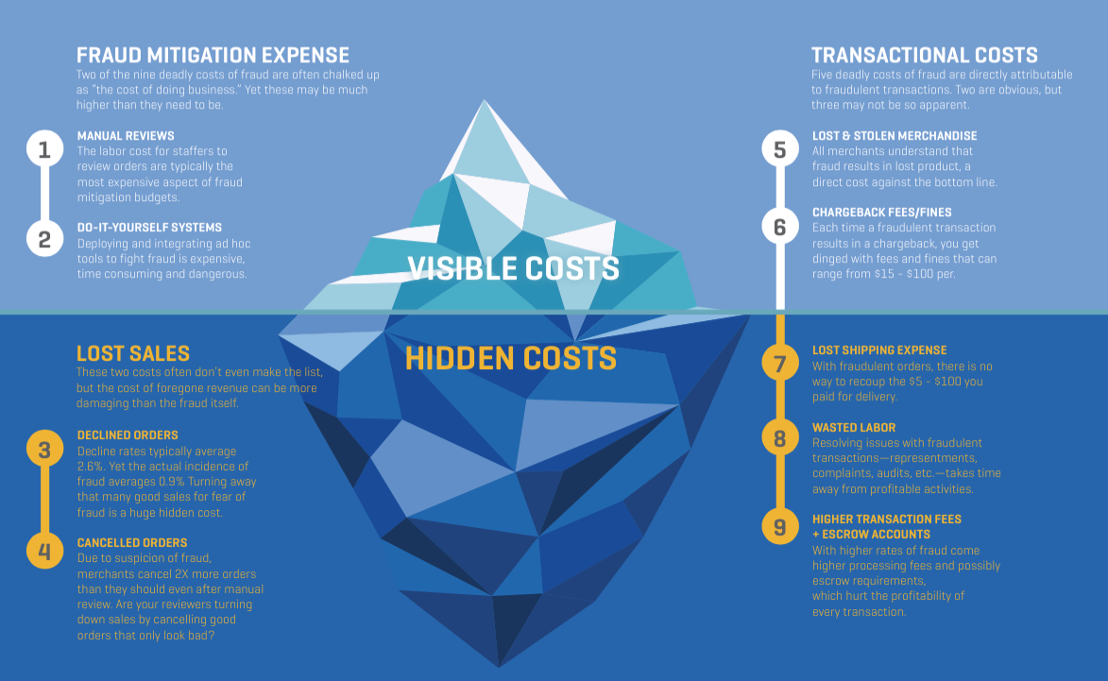
Business Insight

Slide 23
Thank You!

Slide 24

Q&A

Slide 25

Expert Variable Creation
We created 130 expert variables and we kept 40 variables after KS.
Since this analysis involves time, with limited data, we chose four different time windows 1, 3, 7, 15 and 30 days. The rationale is to capture more (and different types of) fraudulent records that might be detected in those time windows.
Furthermore, we kept 25 variables after Lasso, we use these 25 to train our models.

